Slide 1


Assembly Challenges

Slide 2
Challenges
Tiny organisms
Symbionts
Repetitive genomes
Ploidy

Slide 3
Challenges
Tiny organisms

Slide 4
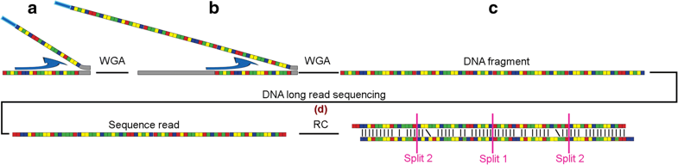
Challenges
Tiny organisms
1x
2x
4x
Warris et al. 2018.

Slide 5
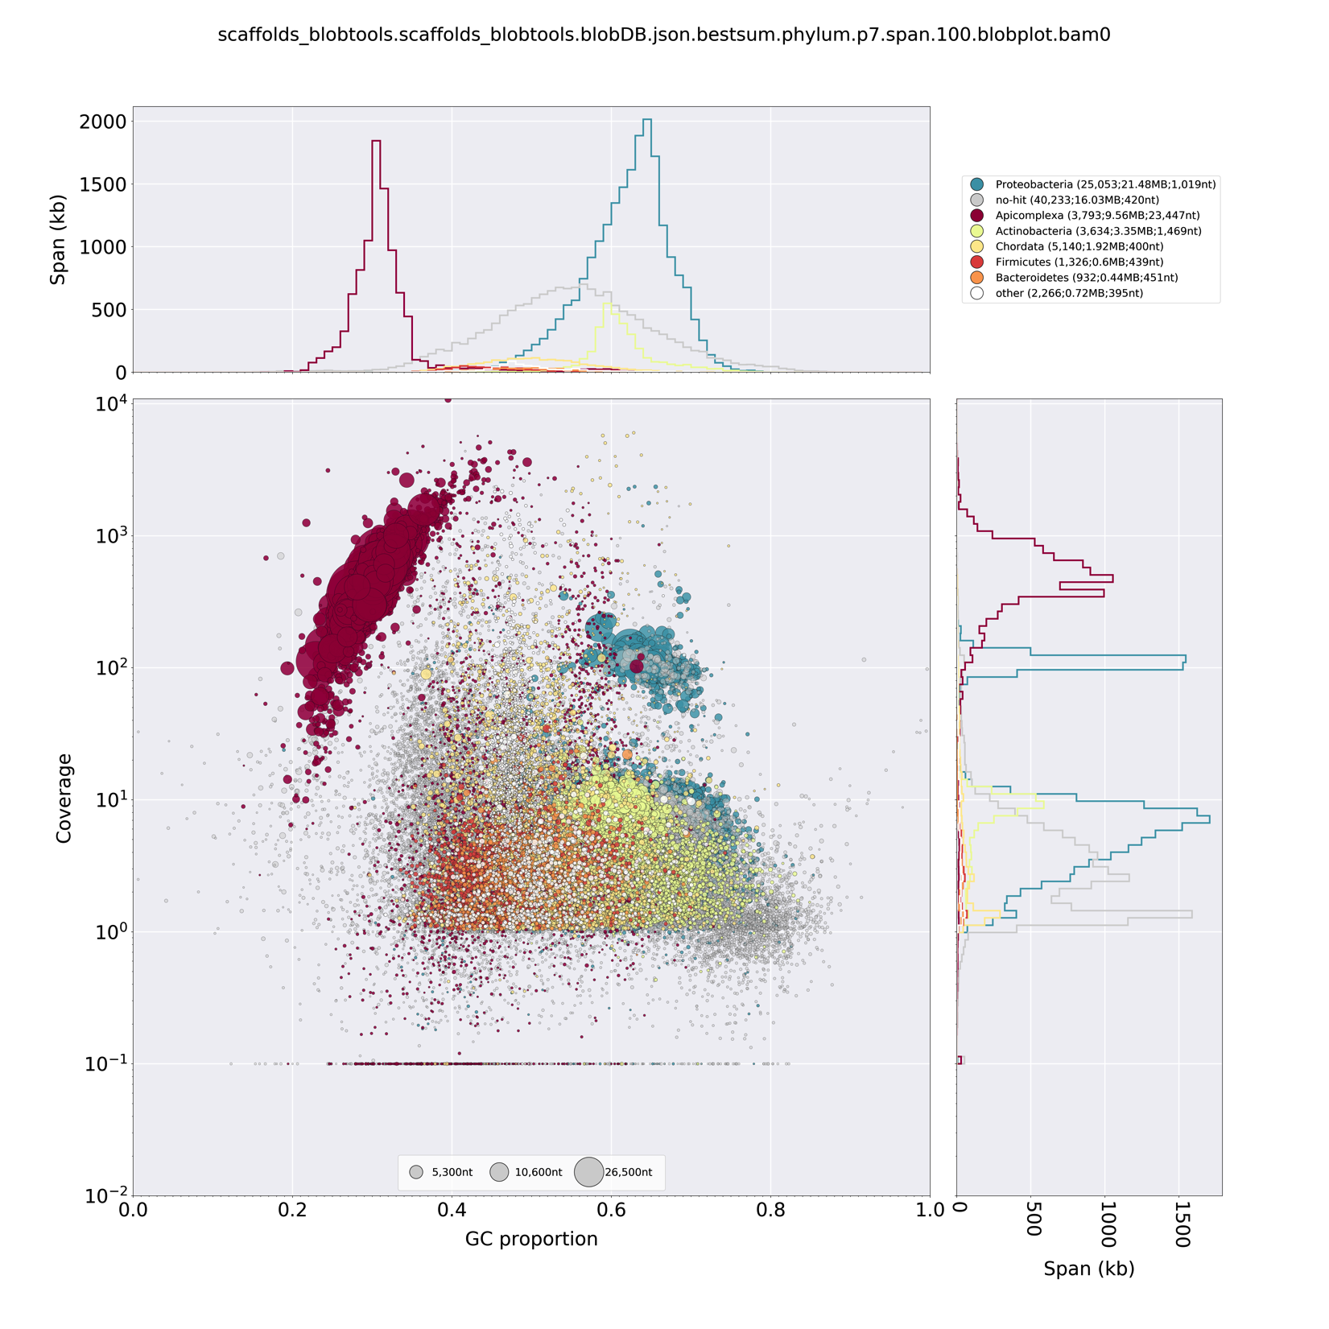
Challenges
Tiny organisms
Amplification
Bias visible
Contaminants visible

Slide 6
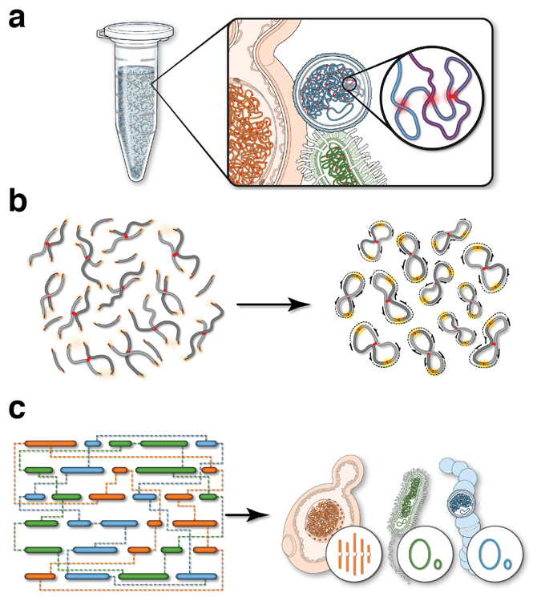
Challenges
Symbionts
Hi-C

Slide 7
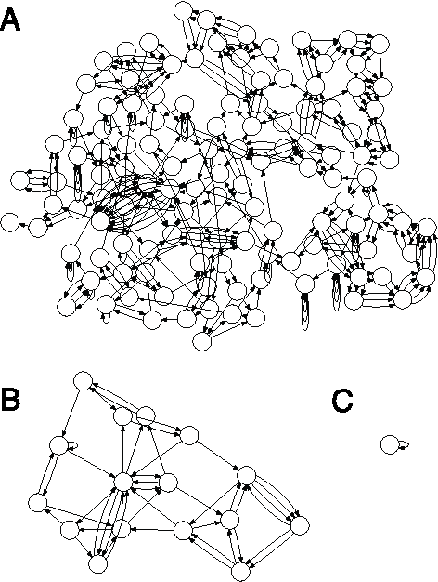
Challenges
Repetitive genomes
E. Coli de Bruijn graph
K = 50
K = 1000
K = 5000
Koren et al. 2013

Slide 8
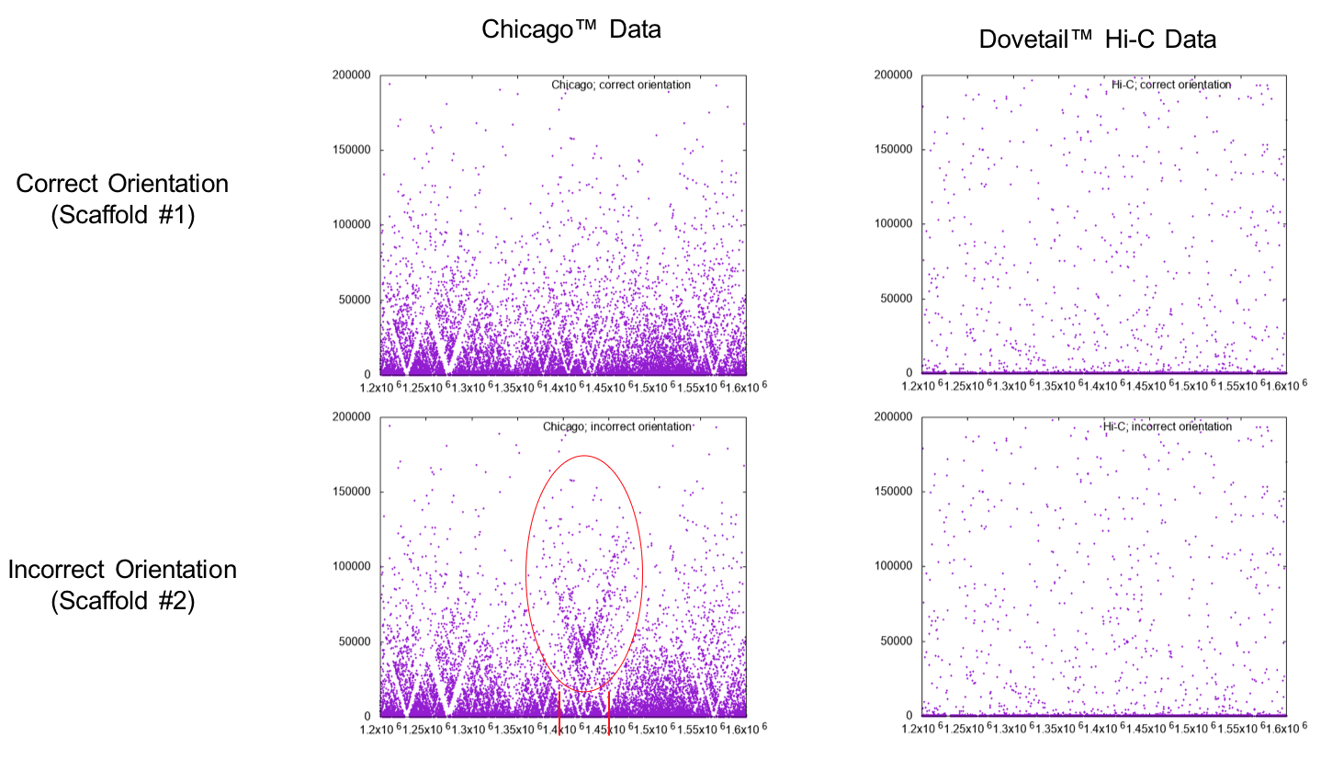
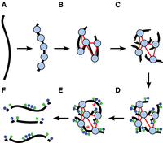
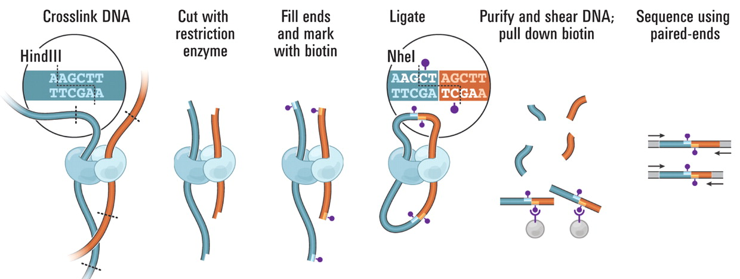
Challenges
Repetitive genomes

Slide 9
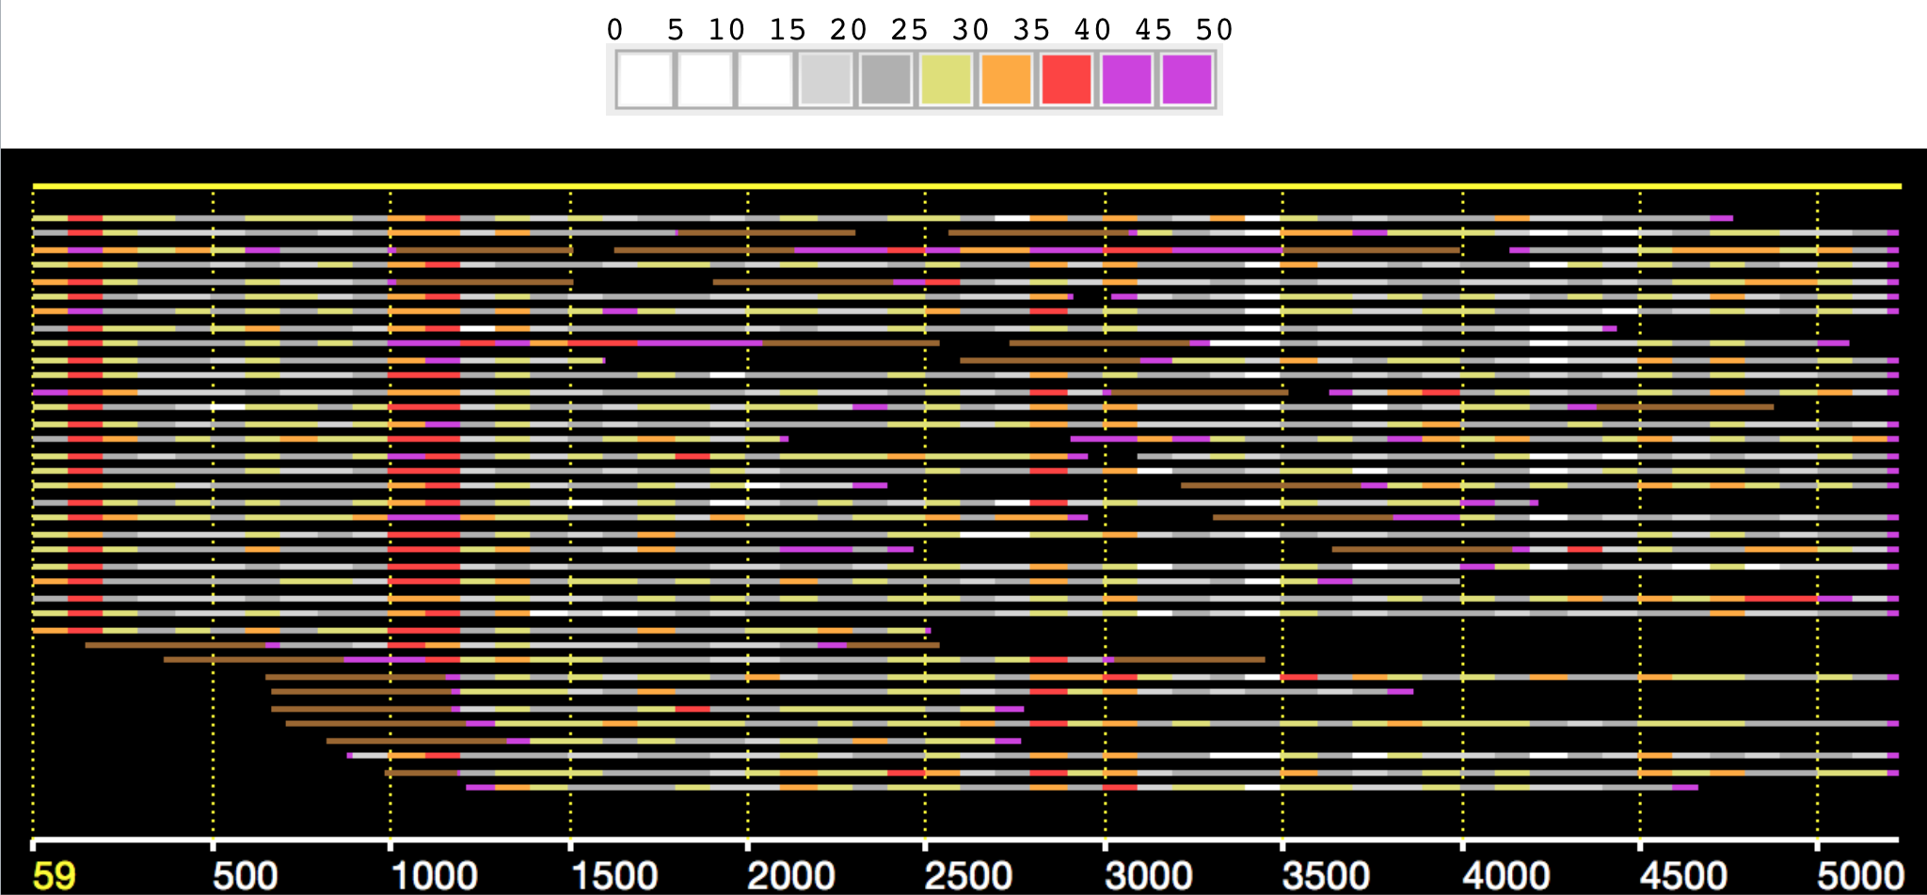
Challenges
Repetitive genomes
Error correction may collapse near identical repeats
Alignments are generally made all-vs-all.

Slide 10
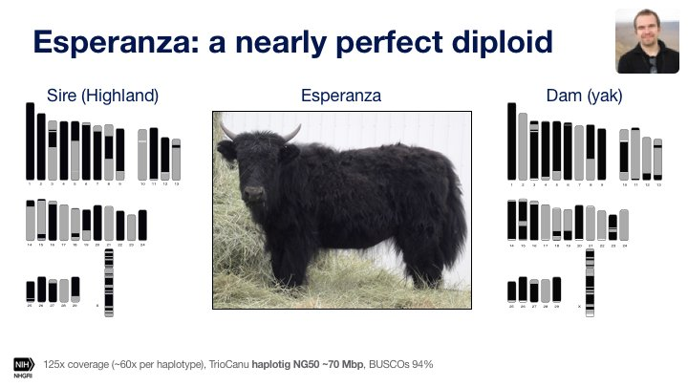
Challenges
Ploidy
The NG90 is 95.3% (dam) and 95.5% (sire) in 58 and 55 haplotigs, respectively
haplotigs = haplotype contigs (no scaffolding)

Slide 11
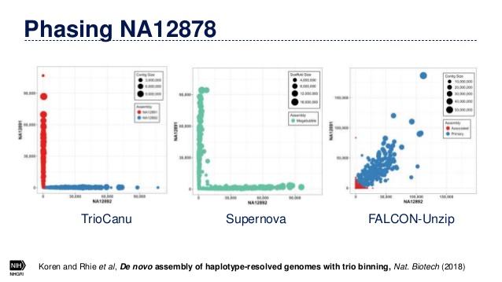
Challenges
Ploidy

Slide 12
Challenges
Data Processing

Slide 13
Challenges
Data Processing
Parallelization
Job Schedulers
GNU parallel
Workflows

Slide 14
Challenges
Data Processing
Job Schedulers
#!/usr/bin/env bash
set -ueo pipefail
PATH="$PATH:/path/to/fqtools"
JOB=$SLURM_ARRAY_TASK_ID
FILES=( /path/to/reads/*_R1.fastq.gz )
FASTQ="${FILES[$JOB]}"
fqtools validate "$FASTQ"
fqtools validate "${FASTQ/_R1./_R2.}"
sbatch -a 0-9 [other options] script.sh

Slide 15
Challenges
Data Processing
GNU parallel
>seq1
ACGTATATNCATATACATATNCATATATAA
>seq2
GCATACAATAANAATACCATAGATTATACC
>seq3
GTATACCATATCATACATAGGAGGGAGNNN
>seq4
TATTTACCCCCATACCACCCCATATTTNAC
zcat file.fasta.gz | parallel --pipe blast [blast_options] -
https://www.biostars.org/p/63816/

Slide 16


Challenges
Data Processing
Workflows
snakemake
nextflow
many, many more …

Slide 17
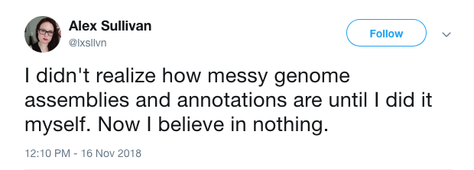
Challenges

